Slide 1
FLOWER RECOGNITION USING CNN
PRESENTED BY:
S.RAMYA
513121104033
THANTHAI PERIYAR GOVERNMENT INSTITUTE OF TECHNOLOGY -VELLORE

Slide 2
PROJECT TITLE
FLOWER RECOGNITION USING CNN
3/21/2024 Annual Review

Slide 3


AGENDA
1.Problem Statement 2.Project overview 3.End Users 4.Solutions and its Proposition 5.The WOW in the solution 6.Modelling 7.Results 8.Conclusion
3/21/2024 Annual Review

Slide 4

PROBLEM STATEMENT
In the era of increasing environmental awareness and interest in plant biodiversity, there is a growing need for automated systems that can accurately identify and classify different types of flowers. The goal of this project is to develop a flower recognition system using deep learning techniques, specifically leveraging the VGG16 model pretrained on imagenet. The system should be able to take an input image of a flower and accurately predict its class, providing users with valuable information about the species and characteristics of the flower. This project aims to contribute to the field of computer vision and botanical research by offering a practical tool for flower identification and classification.
3/21/2024 Annual Review

Slide 5

PROJECT OVERVIEW
Our project focuses on implementing a flower recognition system using deep learning methods, with a particular emphasis on the VGG16 model pretrained on imagenet. The system will take an image of a flower as input and predict its class, providing users with information about the species and characteristics of the flower. The workflow includes loading the pre-trained VGG16 model, preprocessing input images, making predictions, and displaying the image along with the top predicted flower classes and their confidence score vision and botanical research by offering an automated and accurate solution for flower identification and classification
3/21/2024 Annual Review

Slide 6

WHO ARE THE END USERS?
1.Botanists And Researchers 2.Gardeners And Plant Enthusiasts 3.Educational Institutions 4.General Public 5.Conservationists
3/21/2024 Annual Review

Slide 7

YOUR SOLUTION AND ITS VALUE PROPOSITION
The flower recognition system utilizes deep learning techniques, specifically the VGG16 model pretrained on imagenet, to accurately identify and classify different types of flowers based on input images. The workflow involves preprocessing input images, making predictions using the pre-trained model, and displaying the top predicted flower classes and their confidence scores.
The value proposition of this flower recognition project lies in its accuracy, automation, and accessibility. By leveraging deep learning with the VGG16 model, the system provides reliable flower identification for botanists, gardeners, educators, and the general public. Its real-time capabilities and user-friendly interface enhance the user experience, making it a valuable tool for learning, research, and conservation efforts in the field of botany and environmental science.
3/21/2024 Annual Review

Slide 8

THE WOW IN YOUR SOLUTION
Real-time recognition: Implementing real-time recognition capabilities, where users can point their camera at a flower and instantly receive the classification and information about that flower species. This would make the system highly interactive and engaging, providing immediate feedback to users and enhancing their experience
3/21/2024 Annual Review
8

Slide 9
MODELLING
1.Data collection: Gather A diverse dataset of flower images with corresponding labels (flower species). 2.Data preprocessing: Resize all images to A uniform size (E.G., 224x224 pixels) suitable for input to the VGG16 model. Normalize pixel values to A range suitable for the model (E.G., 0 to 1). Split the dataset into training, validation, and test sets. 3.Model selection: Choose A pre-trained deep learning model for image classification, such as VGG16, which has been trained on A large dataset like imagenet.
4.Model training: Load the pre-trained VGG16 model without the top (classification) layer. Add A new fully connected layer on top for flower classification. Train the model using the training set, validating its performance on the validation set. Fine-tune the model's hyperparameters (E.G., Learning rate, batch size) to optimize performance.
9

Slide 10
5.Model evaluation: Evaluate the trained model on the test set to assess its accuracy and performance metrics (e.G., Precision, recall, F1 score). 6.User interface development: Create a user-friendly interface for users to upload images or use a webcam for real-time flower recognition. Implement logic to preprocess input images (resize, normalize) before feeding them to the trained model. 7.Integration and deployment: Integrate the trained model with the user interface to enable flower recognition functionality. Deploy the system on a platform suitable for end users (e.G., Web application, mobile app). 8.Testing and validation: Conduct thorough testing to ensure the system works correctly across different scenarios (e.G., Varying lighting conditions, image quality). Validate the system's accuracy and performance with real-world flower images. 9.User feedback and iteration: Gather feedback from users to identify areas for improvement or additional features
Iterate on the system based on user feedback and incorporate enhancements as needed.

Slide 11
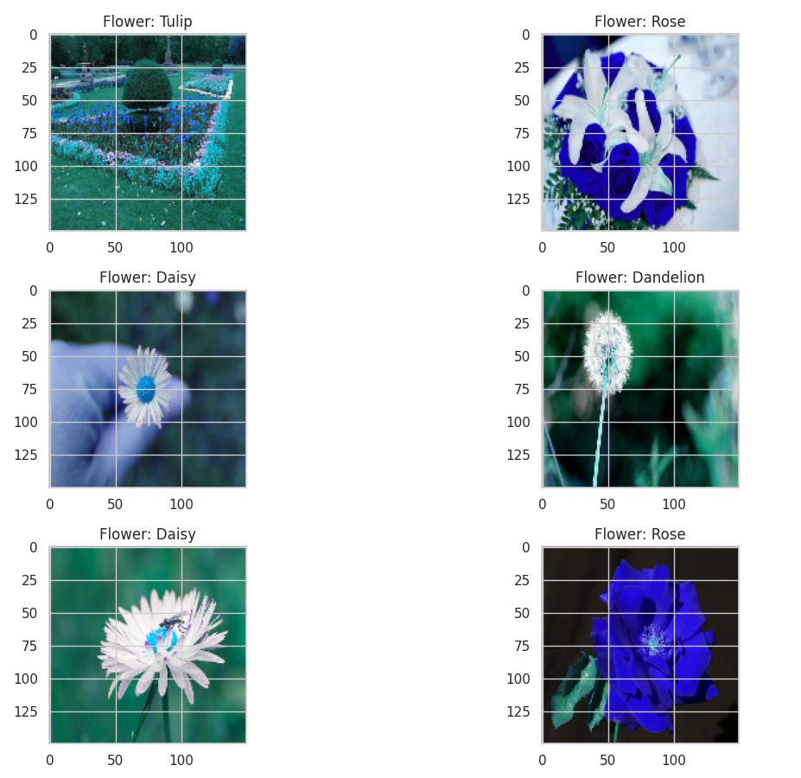
RESULTS
Demo Link
3/21/2024 Annual Review
11

Slide 12
CONCLUSION
In conclusion, this flower recognition project leverages deep learning techniques, specifically the VGG16 model pretrained on imagenet, to accurately identify and classify different types of flowers based on input images. The system offers high accuracy, automation, and accessibility, making it valuable for botanists, gardeners, educators, and the general public. With real-time recognition capabilities and a user-friendly interface, the project aims to enhance the understanding and appreciation of floral biodiversity while contributing to educational, research, and conservation efforts

Slide 13
THANK YOU

